Slide 1







PYEXPO25
Genius innovation leaves behind a legacy...
Team ID: T015
Team Name:Tech Thinkers):
PS Number: PY084
PS Title: Apartment Maintenance Management System
Domain:Web Development
Category:Software
PYEXPO 2025
IPS TECH COMMUNITY

Slide 2
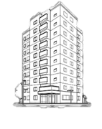
Problem Statement:
This system solves these issues:
Allowing residents to easily lodge maintenance complaints through the app.
Enabling admins to efficiently assign and track tasks.
Providing real-time updates and transparent communication for residents.
Streamlining payment for maintenance services.
The target audience for the system includes:
Apartment Residents – To easily report issues, track progress, and make payments.
Property Managers – To manage and assign maintenance tasks efficiently.
Maintenance Personnel – To receive tasks and provide updates.
PYEXPO 2025
IPS TECH COMMUNITY

Slide 3

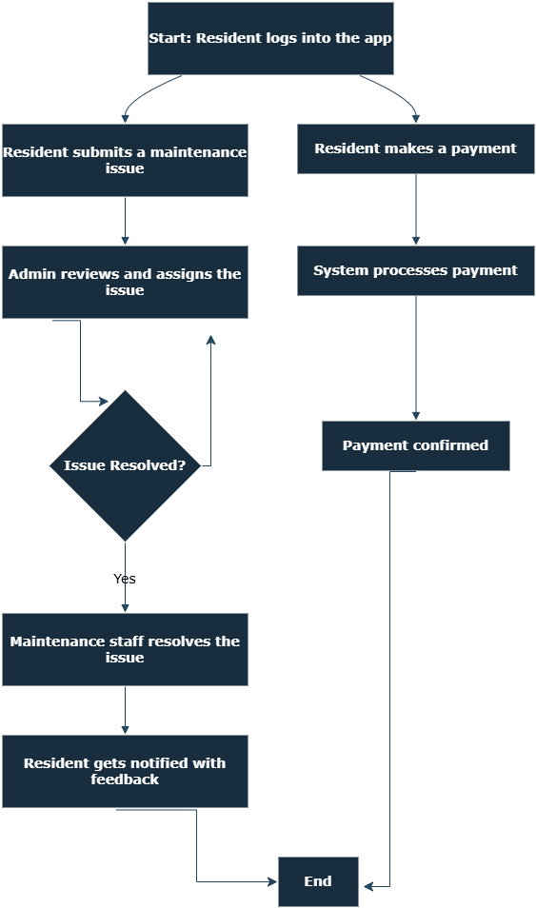
Proposed Solution:
The Apartment Maintenance Management System improves efficiency by automating and streamlining the maintenance request process.
For Tenants:
Easily submit maintenance requests online.
Receive real-time updates on request status.
Track request history for transparency.
For Property Managers:
Centralized dashboard to track all maintenance requests.
Prioritize and assign tasks efficiently.
Optimize costs and resources for better budgeting.
For Maintenance Staff:
Get clear task assignments with priority levels.
Efficient scheduling to reduce delays.
Manage inventory and resources effectively.
PYEXPO 2025
IPS TECH COMMUNITY

Slide 4
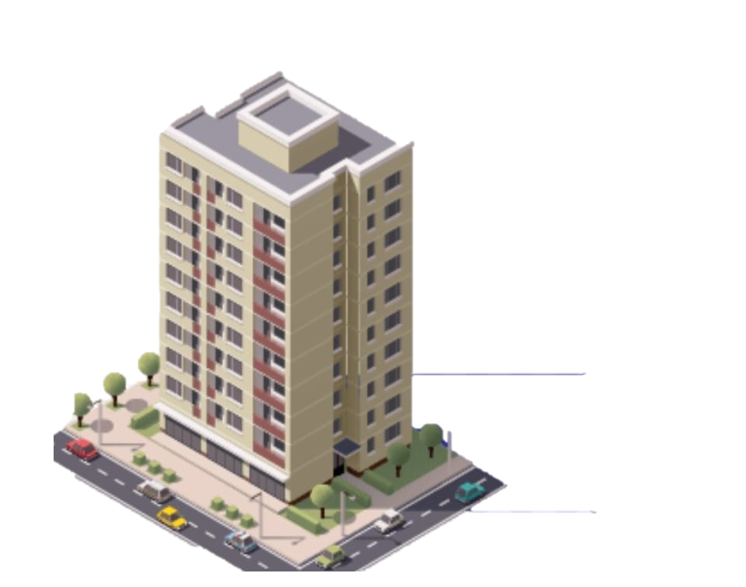
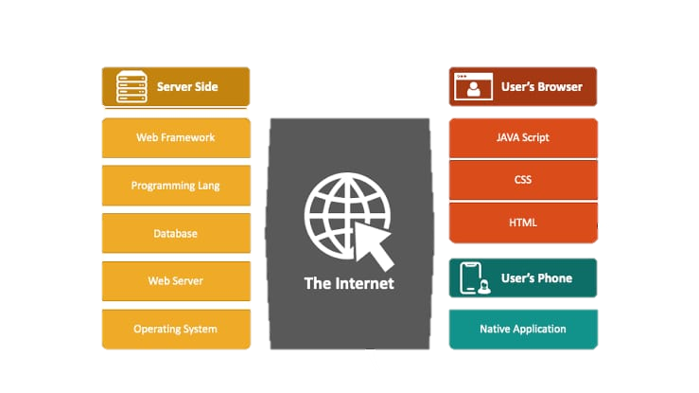
Technology Stack:
Frontend: HTML/CSS, JavaScript
Backend: Python (Django)
Database: MySQL
Application: Web Application
Payment: Stripe/PayPal
Notifications: Firebase/Twilio
PYEXPO 2025
IPS TECH COMMUNITY

Slide 5
Demo:
Add screenshot
PYEXPO 2025
IPS TECH COMMUNITY

Slide 6
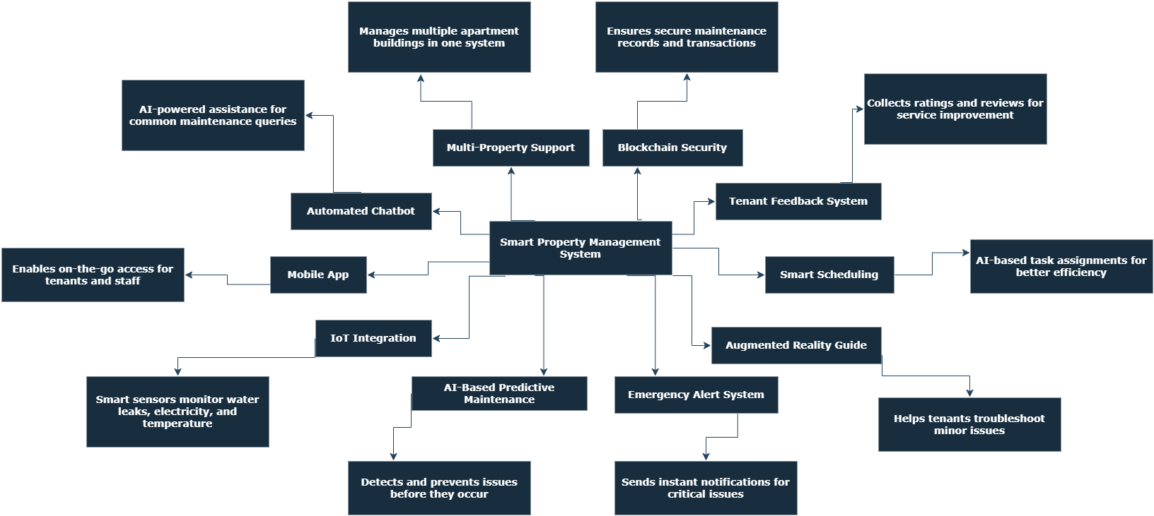

Impact and Future Scope:
Value Creation:
Tenants: Quick requests, real-time updates, faster repairs.
Managers: Centralized tracking, cost control, better retention.
Staff: Clear tasks, smart scheduling, efficient resources.
Saves time, boosts transparency, enhances reputation.
Research and References:
https://www.scribd.com/document/440402869/Apartment-Management-System
https://netmaxims.com/casestudy/guidelight/
https://sloboda-studio.com/work/property-management-system/
PYEXPO 2025
IPS TECH COMMUNITY

Slide 7
Team Member Details:
Name(TL):Praveena Sri R Roll No:24uad217 Dept:AI&DS-B
Name:Umamageshwari K Roll No:24uad257 Dept:AI&DS-B
Name:Ruddhara devi S Roll No:24uad222 Dept:AI&DS-B
Name:Tamizhmathi M Roll No:24uad253 Dept:AI&DS-B
Name:Srimathi T Roll No:24uad244 Dept:AI&DS-B
Name:Samayakeerthika V Roll No:24uad228 Dept:AI&DS-B
PYEXPO 2025
IPS TECH COMMUNITY

Slide 8
THANK YOU !

